Slide 1
History Of Anesthesiology
Name
Institution
Professor
Date

Slide 2
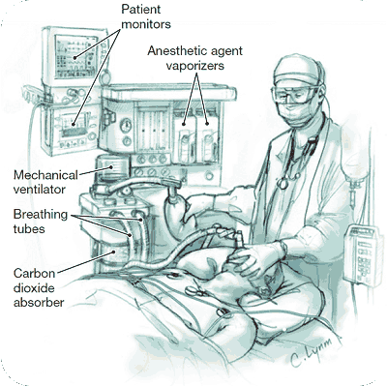
History of anesthesiology
Anesthesia is a perioperative medical procedure of managing pain both during the surgery and after the surgery.
Anesthesiologists administer and observe how a patient is reacting to anesthesia
Anesthesiologists also determine what type of anesthesia is best suited for a particular patient

Slide 3
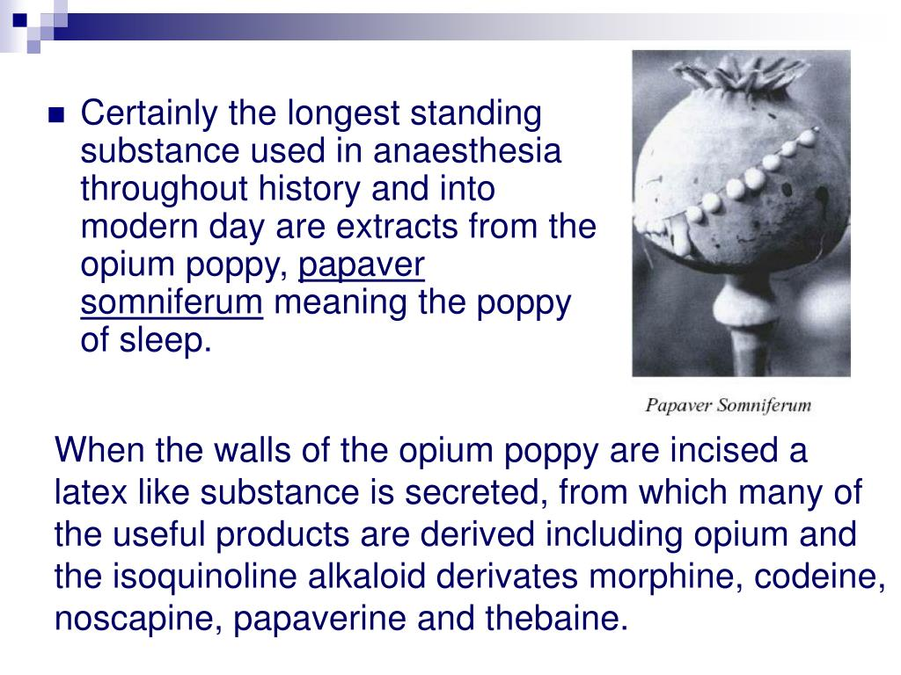
History of anesthesiology
The first use of anesthesia involved the use of a somniferous sponge in the thirteenth century.
Anesthesiology did not begin as a true profession rather as a trade because of societal attitudes that surrounded the management of pain.
Some people argued that the use of anesthesia was unethical and immoral as it tampered with divine plans that surgeries should be painful procedures.

Slide 4
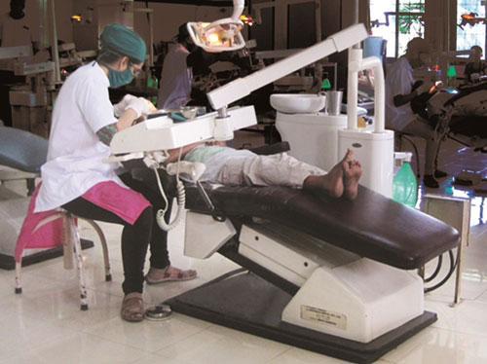
ANESTHESIA IN THE US
Anesthesia in the United States took some time before it was recognized as a profession.
There were no agreements on who should take credit for the discovery of anesthesia for use in surgery.
In 1846, anesthesia was used for the very first time in surgery.

Slide 5

HISTORY OF ANESTHESIOLOGY
During the period of discoveries, anesthesia was administered by nurses as there were no professional anesthetists.
By the end of the nineteenth century, anesthesiology became a profession.

Slide 6

Current state of anesthesiology
Today, anesthesia is a renowned medical care and profession.
Individuals who specialize in anesthesia indulge themselves in perioperative medical procedures and activities.
Anesthesiologists are tasked with ensuring that patients are safe both during and after any surgery.

Slide 7
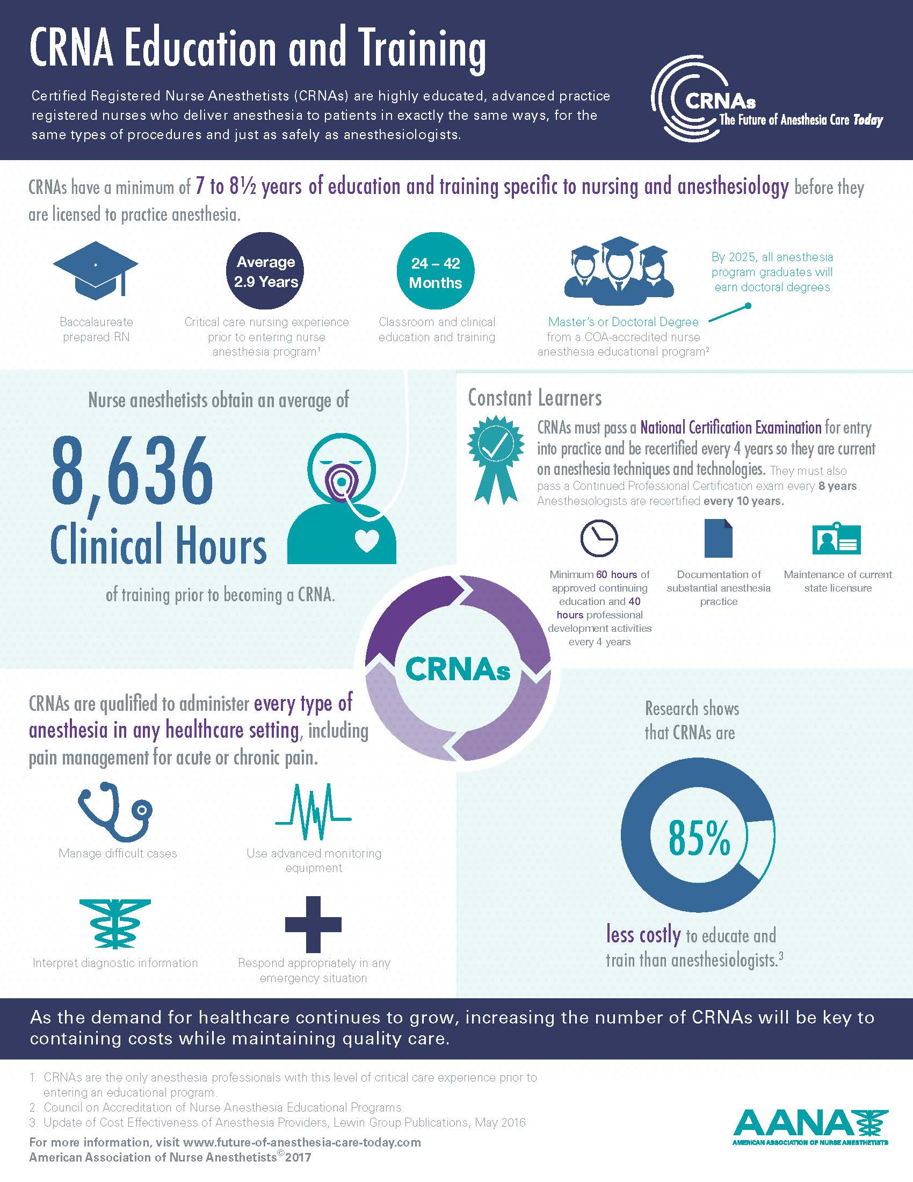
Becoming a professional anesthesiologists
Anesthesiologists today in the United States are required to complete a four-year course on the same.
The course is taken after one passes the pre-med requirements. An individual specializes for four years as an anesthesiologist after completing a four year program in medical school.

Slide 8
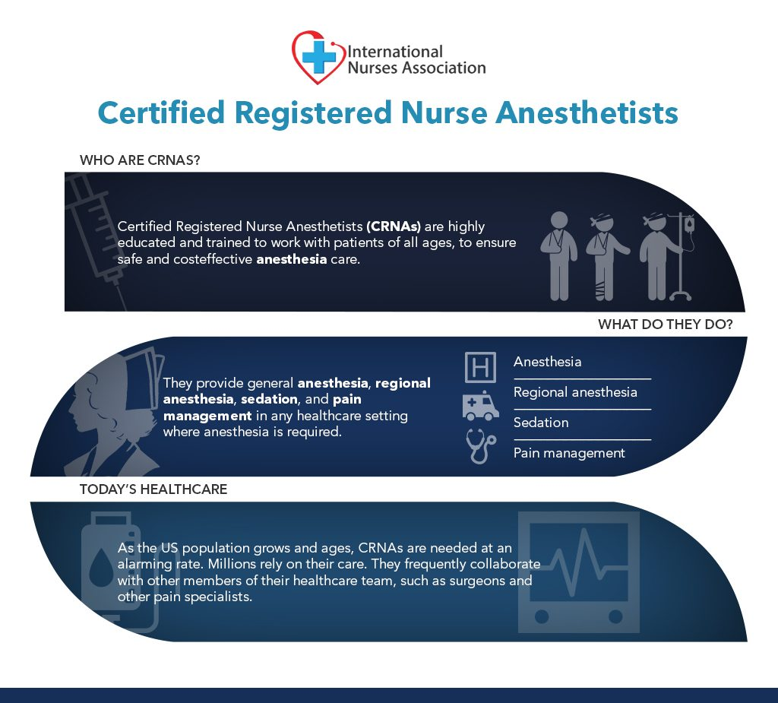
Certification of anesthesiologists
Physician anesthesiologists sit for an exam offered by the American Board of Anesthesiology after which they are certified.
On passing the exam, they are registered and are now eligible to carry out different roles

Slide 9
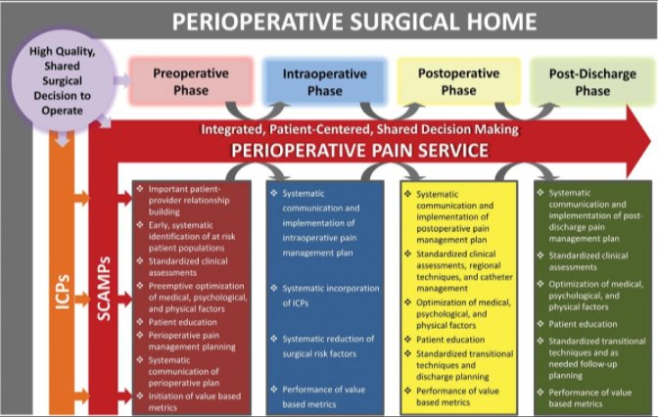
Approaches to be integrated into anesthesiology
Care should be made part of anesthesiology. Anesthesiologists should provide care by following up to know the patient’s progress even after discharge from the hospital
the Perioperative Surgical Home is an ideal structure for integrating care into anesthesiology.

Slide 10
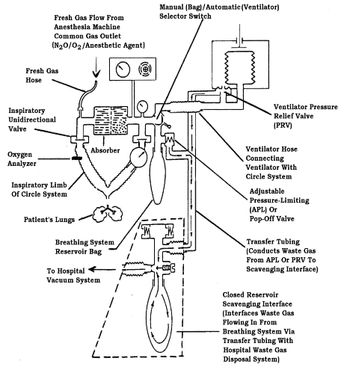
Approaches to be integrated into anesthesiology
Comorbidity should be integrated into anesthesiology to reduce the chances of preventable risks from occurring, requiring complex surgeries
Patient-centered interventions like taking the patient through the surgical procedure before they undergo surgery should be adopted
A patient should understand the whole surgery cycle before making a decision of undergoing it

Slide 11
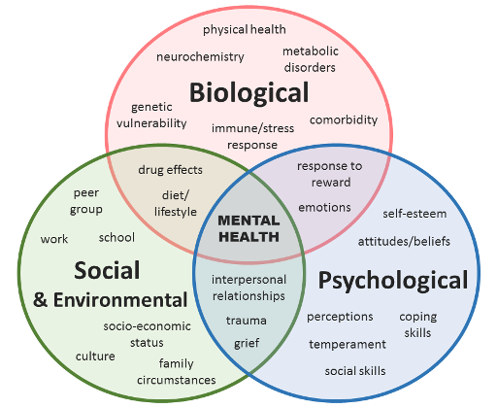
Approaches to be integrated into anesthesiology
The bio psychological model of health should be adopted by anesthesiologists
Besides taking care of the biological needs of a patient, their social and cultural backgrounds as well as spiritual backgrounds should be considered
These spheres impact the patient’s recovery process

Slide 12
The Future Direction Of Integrative Healthcare
Integrative healthcare should also take consideration of the existing cultural knowledge on health
Cultural backgrounds and beliefs of individuals affect their approaches to western medicine
Culture also affects an individual’s lifestyle exposing them to life satisfaction or dissatisfaction which can help explain stress levels.
Technology should be part of integrative healthcare.
The analysis of cultural backgrounds of patients can change the approach of medics in handling certain medical conditions

Slide 13
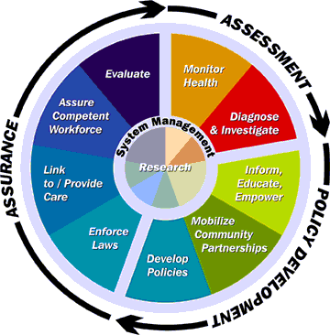
The Future Direction Of Integrative Healthcare
There should be an integrated care system where individuals can receive comprehensive care upon seeking one type of care
Participation should also be made part of health care systems. Patients should be allowed to participate in making decisions that regard their health care

Slide 14

The Future Direction Of Integrative Medicine
Integrative medicine should leverage on the use of mobile health.
Medical information should be available to people from their mobile phones.
Medical professionals should also be mobile enough to visit and assess patients from their points of references as some of them may not have access to health facilities.

Slide 15
The Future Direction Of Integrative Medicine
These mobile apps should help medical practitioners collect information on heart rate, and blood pressure.
The information should then be shared among the health professionals to ensure the individuals are monitored and urgent care accorded those who may be in need of it.
The information recorded from these mobile apps could also be used to develop customized therapies for a particular group of people in society to prevent the likelihood of further risks from occurring
The apps also help patients to seek urgent medical attention and also monitor their own health progress. The apps should also be revamped so that they can offer alerts to patients

Slide 16
The Future Direction Of Inter-Professional Practice
Educational programs that offer inter-professional training should also be developed to enhance inter-professional collaboration
Dentists, nurses, anesthesiologists, physical therapists, social workers, occupational therapists and pharmacists should undergo a curriculum that equips them with coordinated care skills.
Inter-professional practice should include care coordination. The approach should include assessment-based and an inter-disciplinary approaches to healthcare.
Social supportive services should be offered in line with health care at cost friendly prices to ensure all the people who need the services benefit from them.

Slide 17
The Future Direction Of Inter-Professional Practice
Inter-professional practice should include care coordination.
Inter-professional practice should entail assessment-based and an inter-disciplinary approaches to healthcare.
Social supportive services should be offered in line with health care at cost friendly prices to ensure all the people who need the services benefit from them.
An individual’s needs should be assessed by an expert and a care plan that is comprehensive of all the needs needed by that individual developed and administered through coordinated efforts of health care professionals

Slide 18
Interesting facts about anesthesiology in the US
According to the Bureau of Labor Statistics, there are twenty nine thousand, two hundred and twenty anesthesiologists in the united states as of March 2017
The US news and world health report, ranked anesthesiologists as one the best paying jobs with anesthesiologists being paid an average salary of $187,200 annually
The unemployment rates among anesthesiologists was 1.7% as of 2017
Three-quarters of anesthesiologists are males as revealed by the Locum Tenes.com report of 2017
Only 83% of anesthesiologists were certified by the American Board of Anesthesiologists as of 2017
A certified nurse anesthetist in the united states earns an average of $160,250 annually

Slide 19
Interesting facts about anesthesia
A study that was published in May 2019 in the journal of the American Osteopathic Association revealed that people who take marijuana daily or even on a weekly basis need a double amount of anesthesia in surgeries when compared to people who do not use marijuana
According to the American Society of Anesthesiologists, it is possible for an individual to wake up during a surgery. This happens to every one or two people out of one thousand people undergoing surgeries that involve general anesthesia
A study published in the Augusts 2018 issue of the British Journal of Anesthesia showed that anesthesia exposure is likely to trigger a decline in the brain functionality causing memory problems
According to the national Institutes of Health, sixty thousand patients undergo different types of surgeries involving anesthesia every day
People who smoke need extra anesthesia as compared to those who do not smoke. A research report by the European Society of Anesthesiology in 2015 revealed that a women who smoked needed an extra 33percent anesthesia during operations than non-smoking women

Slide 20
Thank you
Any question??

